Slide 1
Skin

Slide 2
Smooth Skin Algorithm

Slide 3



Weighted Blending & Averaging
$$x=\sum_{i}{w_{i}x_{i}}$$
Weighted sum:
Weighted average:
Convex average:
$$\sum_{i}{w_{i}}=1$$
$$0≤w_{i}≤1$$

Slide 4

Rigid Parts
Robots and mechanical creatures can usually be rendered with rigid parts and don’t require a smooth skin
To render rigid parts, each part is transformed by its world matrix independently
In this situation, every vertex of the character’s geometry is transformed by exactly one matrix
where v is defined in its local space
$$v′=Wv$$

Slide 5
Simple Skin
A simple improvement for low-medium quality characters is to rigidly bind a skin to the skeleton. This means that every vertex of the continuous skin mesh is attached to a link.
In this method, as with rigid parts, every vertex is transformed exactly once and should therefore have similar performance to rendering with rigid parts.
$$v′=Wv$$

Slide 6
Smooth Skin
With the smooth skin algorithm, a vertex can be attached to more than one link with adjustable weights that control how much each joint affects it
Vertices rarely need to be attached to more than three links
Each vertex is transformed a few times and the results are blended
The smooth skin algorithm has many other names: blended skin, skeletal subspace deformation (SSD), multi-matrix skin, matrix palette skinning…

Slide 7


Smooth Skin Algorithm
The deformed vertex position is a weighted average:
$$v′=w_{1}\left(M_{1}v\right)+w_{2}\left(M_{2}v\right)+⋯+w_{N}\left(M_{N}v\right)$$
Or:
$$v′=\sum_{i}{w_{i}\left(M_{i}v\right)}$$
Where:
$$\sum_{i}{w_{i}}=1$$

Slide 8

Binding Matrices
With rigid parts or simple skin, v can be defined local to the link that transforms it
With smooth skin, several links transform a vertex, but it can’t be defined local to all of them
Instead, we must first transform it to be local to the link that will then transform it to the world
To do this, we use a binding matrix B for each link that defines where the link was when the skin was attached and premultiply its inverse with the world matrix:
$$M_{i}=W_{i}B_{i}^{−1}$$

Slide 9

Normals
To compute shading, we need to transform the normals to world space also
Because the normal is a direction vector, we don’t want it to get the translation from the matrix, so we only need to multiply the normal by the upper 3x3 portion of the matrix
For a normal bound to only one joint:
$$n′=Wn$$

Slide 10
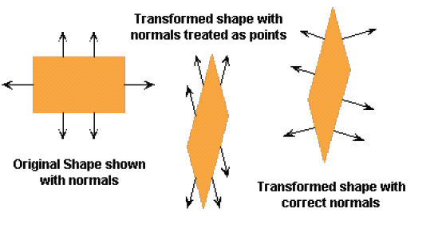
Transforming Normals
It’s tempting to think of normal vectors as being like porcupine quills, so they would transform like points
However, it is not so, consider the 2D affine transformation below
We need a different rule to transform normals

Slide 11













Normals Transform Like Planes
A plane can be written:
where ,
is the plane normal, is the offset
If is transformed, how should transform?
To find the answer, do some magic:
to transform points
to transform normals
$$ax+by+cz+d=0$$
$$n^{T}p=0$$
$$n={\left[\begin{matrix}\begin{matrix}a & b\end{matrix} & \begin{matrix}c & d\end{matrix}\end{matrix}\right]}^{T}$$
$$p={\left[\begin{matrix}\begin{matrix}x & y\end{matrix} & \begin{matrix}z & 1\end{matrix}\end{matrix}\right]}^{T}$$
$${\left[\begin{matrix}a & b & c\end{matrix}\right]}^{T}$$
$$d$$
$$p$$
$$n$$
$$p^{′}=Mp$$
$$0=n^{T}p=n^{T}Ip=n^{T}\left(M^{−1}M\right)p$$
$$={\left({M^{−1}}^{T}n\right)}^{T}\left(Mp\right)$$
$$={n^{′}}^{T}p′$$
$$n′={M^{−1}}^{T}n$$

Slide 12


Normals
For smooth skin, we must blend the normal as with the positions, but the normal must then be renormalized:
If the matrices have non-rigid transformations, then technically, we should use:
$$n^{′}=\frac{\sum_{i}{w_{i}\left(M_{i}n\right)}}{\left\|\sum_{i}{w_{i}\left(M_{i}n\right)}\right\|}$$
$$n^{′}=\frac{\sum_{i}{w_{i}\left({{M_{i}}^{−1}}^{T}n\right)}}{\left\|\sum_{i}{w_{i}\left({{M_{i}}^{−1}}^{T}n\right)}\right\|}$$

Slide 13
Algorithm Overview
Skin::Update() (view independent processing)
Compute skinning matrix for each link: M= W · B⁻¹ (you can precompute and store B⁻¹ instead of B)
Loop through vertices and compute blended position & normal
Skin::Draw() (view dependent processing)
Set matrix state to Identity (world)
Loop through triangles and draw using world space positions & normals

Slide 14


Rig Data Flow
Input DOFs
Rigging system
(skeleton, skin…)
Output renderable mesh
(vertices, normals…)
$$Φ=\left[\begin{matrix}φ_{1} & … & φ_{N}\end{matrix}\right]$$
Rig
$$v^{′}, n′$$

Slide 15




Smooth Skin Algorithm
The deformed vertex position is a weighted average over all of the joints that the vertex is attached to:
W is a joint’s world matrix and B is a joint’s binding matrix that describes where it’s world matrix was when it was attached to the skin model (at skin creation time)
Each joint transforms the vertex as if it were rigidly attached, and then those results are blended based on user specified weights
All of the weights must add up to 1:
Blending normals is essentially the same, except we transform them as direction vectors (x,y,z,0) and then renormalize the results
$$v′=\sum_{i}{w_{i}\left(W_{i}B_{i}^{−1}v\right)}$$
$$1=\sum_{i}{w_{i}}$$
$$n^{∗}=\sum_{i}{w_{i}\left(W_{i}B_{i}^{−1}n\right)}$$
$$n′=\frac{n^{∗}}{\left\|n^{∗}\right\|}$$

Slide 16





Skinning Equations
Skeleton
Skinning
$$L=L_{link}\left(φ_{1},…,φ_{N}\right)$$
$$W=W_{parent}L$$
$$v′=\sum_{i}{w_{i}\left(W_{i}B_{i}^{−1}v\right)}$$
$$n^{∗}=\sum_{i}{w_{i}\left(W_{i}B_{i}^{−1}n\right)}$$
$$n′=\frac{n^{∗}}{\left\|n^{∗}\right\|}$$

Slide 17
Using Skinning

Slide 18
Limitations of Smooth Skin
Smooth skin is very simple and quite fast, but its quality is limited
The main problems are:
Joints tend to collapse as they bend more
Very difficult to get specific control
Unintuitive and difficult to edit
Still, it is built in to most 3D animation packages
If nothing else, it is a good baseline upon which more complex schemes can be built

Slide 19
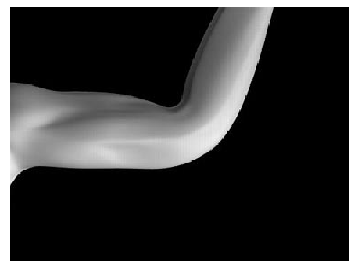
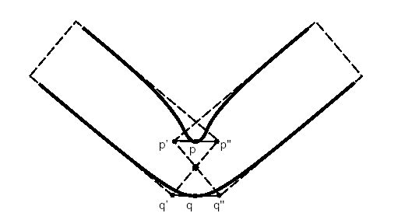
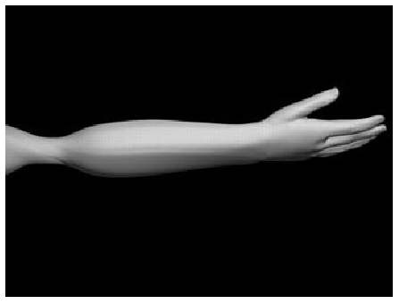
Limitations of Smooth Skin

Slide 20
Bone Links
To help with the collapsing joint problem, one option is to use bone links
Bone links are extra joints inserted in the skeleton to assist with the skinning
They can be automatically added based on the joint’s range of motion. For example, they could be added so as to prevent any joint from rotating more than 60 degrees.
This is a simple approach used in some real time games, but doesn’t go very far in fixing the other problems with smooth skin.

Slide 21
Muscles & Other Effects
One can add custom effects such as muscle bulges as additional joints
For example, the bicep could be a translational or scaling joint that smoothly controls some of the verts in the upper arm. Its motion could be linked to the motion of the elbow rotation.
With this approach, one can also use skin for muscles, fat bulges, facial expressions, and even simple clothing

Slide 22
Rigging Process
To rig a skinned character, one must have a geometric skin mesh and a skeleton
Usually, the skin is built in a relatively neutral pose, often in a comfortable standing pose
The skeleton, however, might be built in more of a zero pose where the links’ DOFs are assumed to be 0, causing a very stiff, straight pose
To attach the skin to the skeleton, the skeleton must first be posed into a binding pose
Once this is done, the verts can be assigned to links with appropriate weights

Slide 23
Skin Binding
Attaching a skin to a skeleton is not a trivial problem and usually requires automated tools combined with extensive interactive tuning
Binding algorithms typically involve heuristic approaches
Some general approaches:
Containment
Point-to-line mapping
Delaunay tetrahedralization

Slide 24
Containment Binding
With containment binding algorithms, the user manually approximates the body with volume primitives for each bone (cylinders, ellipsoids, spheres…)
The algorithm then tests each vertex against the volumes and attaches it to the best fitting bone
Some containment algorithms attach to only one bone and then use smoothing as a second pass. Others attach to multiple bones directly and set skin weights
For a more automated version, the volumes could be initially set based on the bone lengths and child locations

Slide 25
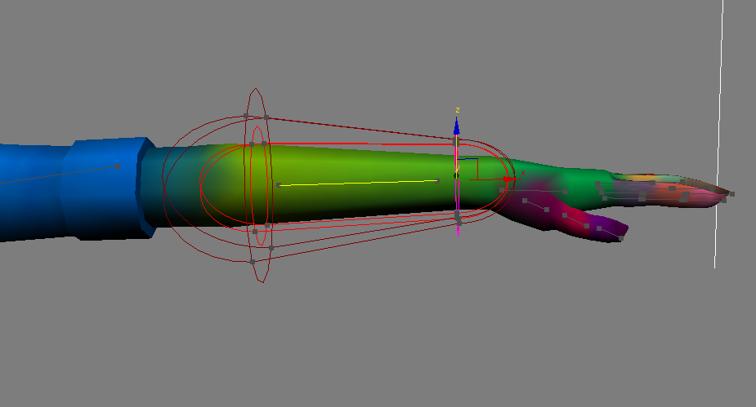
Containment Binding
Volume primitives around the bones
Boxes, cylinders, etc.
Vertex weights assigned based on which primitives it is in
Notes:
25

Slide 26
Point-to-Line Mapping
A simple way to attach a skin is treat each bone as one or more line segments and attach each vertex to the nearest line segment
A bone is made from line segments connecting the joint pivot to the pivots of each child

Slide 27
Delaunay Tetrahedralization
This tricky computational geometry technique builds a tetrahedralization of the volume within the skin
The tetrahedra connect all of the skin verts and skeletal pivots in a relatively clean ‘Delaunay’ fashion
The connectivity of the mesh can then be analyzed to determine the best attachment for each vertex

Slide 28
Hardware Skinning
The smooth skinning algorithm is simple and popular enough to have some direct support in 3D rendering hardware
Actually, it just requires standard vector multiply/add operations and so can be implemented in OpenGL shaders

Slide 29
Skin Memory Usage
For each vertex, we need to store:
Rendering data (position, normal, color, texture coords…)
Skinning data (number of attachments, bone index, weight…)
If we limit the character to having at most 256 bones, we can store a bone index as a byte
If we limit the weights to 256 distinct values, we can store a weight as a byte (this gives us a precision of 0.004%, which is fine)
If we assume that a vertex will attach to at most 4 bones, then we can compress the skinning data to (1+1)*4 =8 bytes per vertex (64 bits)
In fact, we can even squeeze another 8 bits out of that by not storing the final weight, since
w3 = 1 – w0 – w1 – w2

